Slide 1



5 Mark Activity
Web Programming
Student: Shukirillaev Mukhammad Sodik Sherzodbek Ugli
Department:Computer Engineering

Slide 2
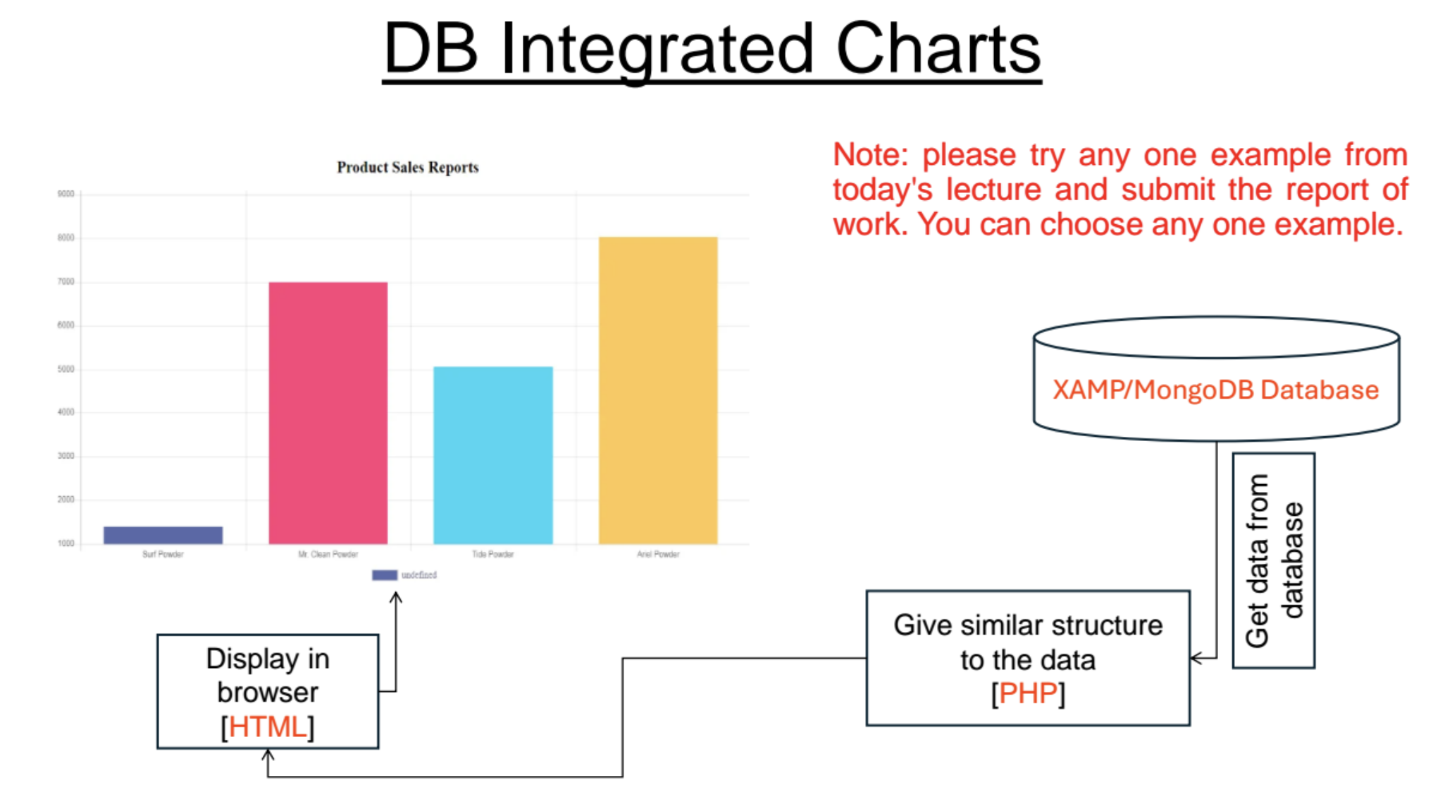
Question:

Slide 3
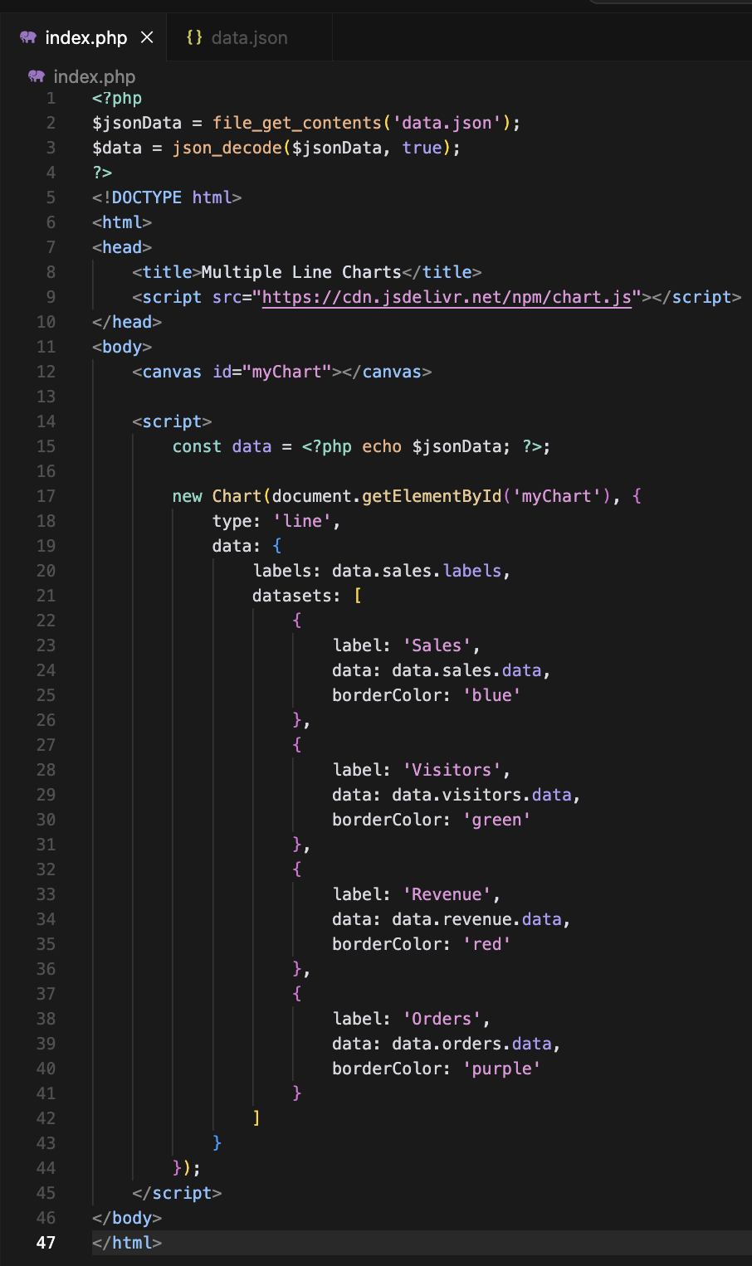
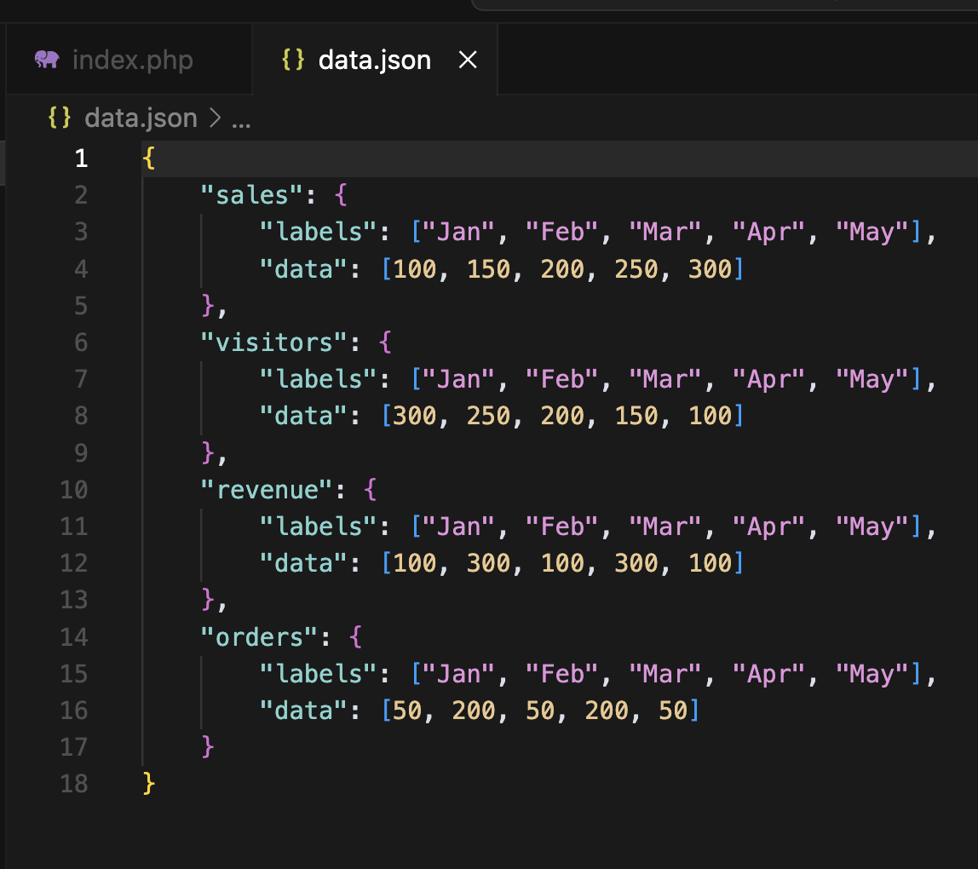
Code:

Slide 4
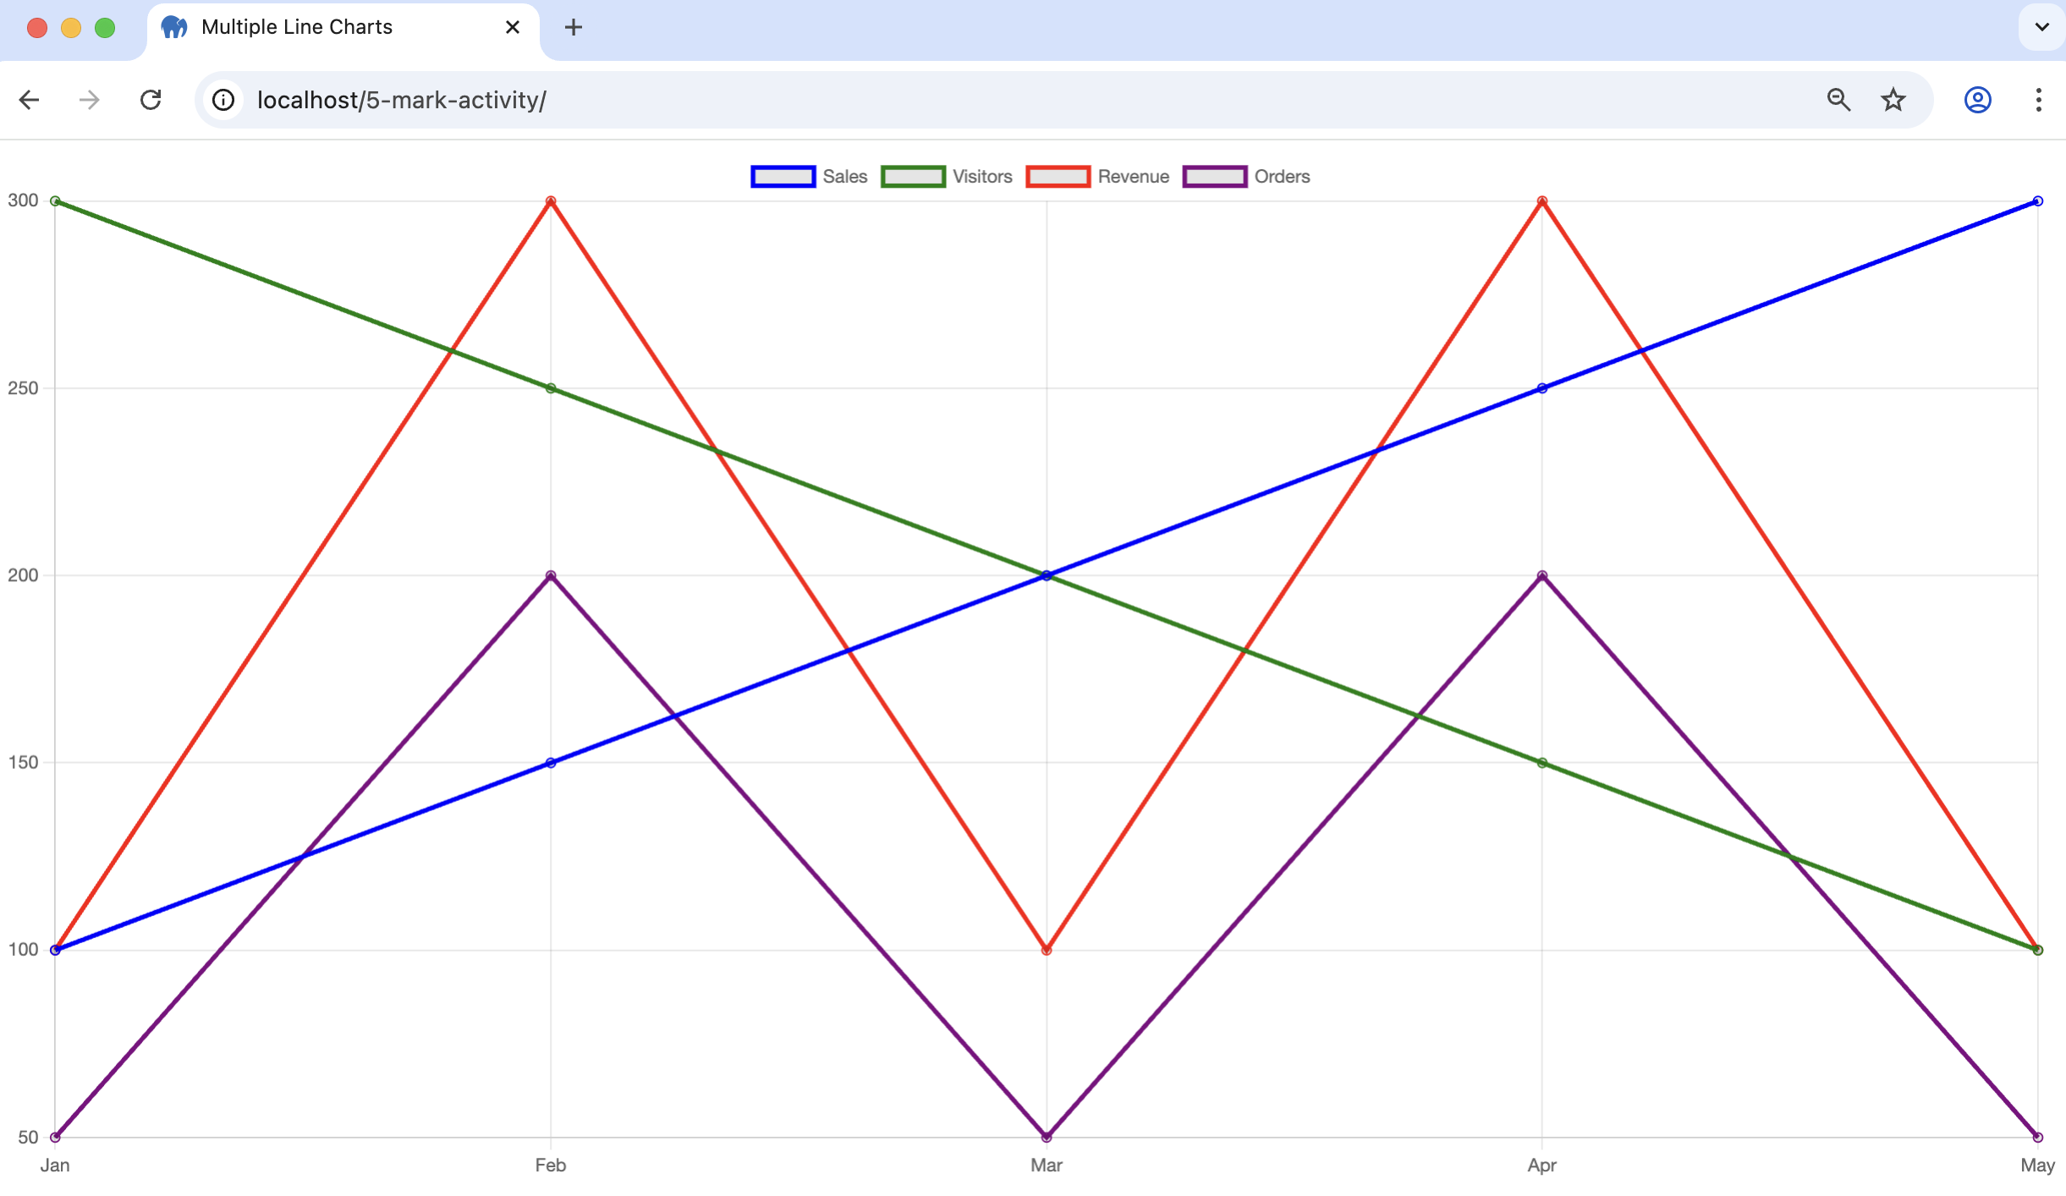
Result

